Slide 1
Structs
Lecture # 05 OOP

Slide 2
Struct & Functions
A function cannot return a value of type array.
A struct variable can be passed as a parameter either by value or by reference.
A function can return a value of type struct.

Slide 3
void printStudent(studentType student)
{
cout << student.firstName << " " << student.lastName
<< " " << student.courseGrade
<< " " << student.testScore
<< " " << student.programmingScore
<< " " << student.GPA << endl;
}

Slide 4
void readIn(studentType& student)
{
int score;
cin >> student.firstName >> student.lastName;
cin >> student.testScore >> student.programmingScore;
cin >> student.GPA;
}
readIn(newStudent);

Slide 5
Arrays vs Structs
Aggregate Operations | Arrays | Structs
Arithmetic | No | No
Assignment | No | Yes
I/Os | No | No
Comparison | No | No
Function return Value | No | Yes

Slide 6
Arrays in Structs
const int ARRAY_SIZE = 1000;
struct listType
{
int listElem[ARRAY_SIZE]; //array containing the list
int listLength; //length of the list
};

Slide 7
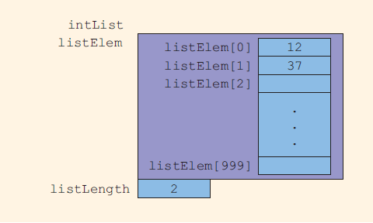

Slide 8
Adding elements in Arrays
listType intList;
intList.listLength = 0;
intList.listElem[0] = 12;
intList.listLength++;
intList.listElem[1] = 37;
intList.listLength++;

Slide 9
Searching
int seqSearch(const listType& list, int searchItem)
{
int loc;
bool found = false;
for (loc = 0; loc < list.listLength; loc++)
if (list.listElem[loc] == searchItem)
{
found = true;
break;
}
if (found)
return loc;
else
return -1;
}
Notes:
Notice that the formal parameter list of the function seqSearch is declared as a constant reference parameter. This means that list receives the address of the corresponding actual parameter, but list cannot modify the actual parameter.
when a variable is passed by value, the formal parameter copies the value of the actual parameter. Therefore, if the formal parameter modifies the data, the modification has no effect on the data of the actual parameter.

Slide 10
Suppose that a struct has several data members requiring a large amount of memory to store the data.
You need to pass a variable of that struct type by value.
The corresponding formal parameter then receives a copy of the data of the variable.
The compiler must then allocate memory for the formal parameter in order to copy the value of the actual parameter.
This operation might require, in addition to a large amount of storage space, a considerable amount of computer time to copy the value of the actual parameter into the formal parameter.
On the other hand, if a variable is passed by reference, the formal parameter receives only the address of the actual parameter.
An efficient way to pass a variable as a parameter is by reference.
If a variable is passed by reference, then when the formal parameter changes, the actual parameter also changes.
Sometimes, however, you do not want the function to be able to change the values of the actual parameter.
In C++, you can pass a variable by reference and still prevent the function from changing its value.
This is done by using the keyword const in the formal parameter declaration.

Slide 11
Array of Structs
struct employeeType
{
string firstName;
string lastName;
int personID;
string deptID;
double yearlySalary;
double monthlySalary;
double yearToDatePaid;
double monthlyBonus;
};
employeeType employees[50];

Slide 12
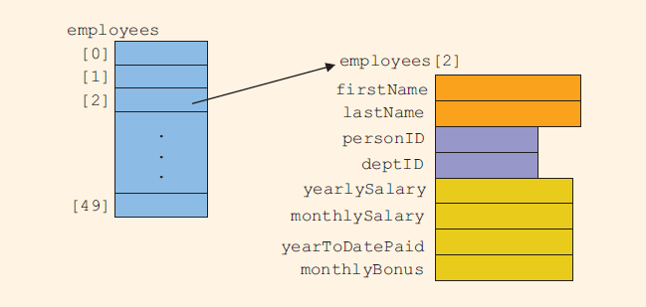

Slide 13
Structs within Structs
To organize information
Huge structs with lot of members can be broken down to smaller structs.
More feasible and understandable.

Slide 14
struct employeeType
{
string firstname;
string middlename;
string lastname;
string empID;
string address1;
string address2;
string city;
string state;
string zip;
int hiremonth;
int hireday;
int hireyear;
int quitmonth;
int quitday;
int quityear;
string phone;
string cellphone;
string fax;
string pager;
string email;
string deptID;
double salary;
};

Slide 15
This struct has 22 members.
Some members of this struct will be accessed more frequently than others.
Some members are more closely related than others.
Moreover, some members will have the same underlying structure.

Slide 16
struct nameType
{
string first;
string middle;
string last;
};
struct addressType
{
string address1;
string address2;
string city;
string state;
string zip;
};
struct dateType
{
int month;
int day;
int year;
};
struct contactType
{
string phone;
string cellphone;
string fax;
string pager;
string email;
};

Slide 17
struct employeeType
{
nameType name;
string empID;
addressType address;
dateType hireDate;
dateType quitDate;
contactType contact;
string deptID;
double salary;
};
employeeType newEmployee;

Slide 18


Slide 19
Accessing Members
newEmployee.name.first = "Mary";
newEmployee.name.middle = "Beth";
newEmployee.name.last = "Simmons";
cin >> newEmployee.name.first;

Slide 20
for (int j = 0; j < 100; j++)
cin >> employees[j].name.first >> employees[j].name.middle >> employees[j].name.last;

Slide 21
Example
Retrieve Struct data from file and console.
Write the resultant data to a file after processing

